Slide 1


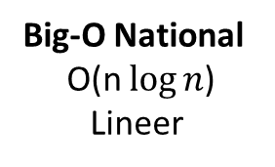
16 | 21 | 11 | 8 | 12 | 22
$2^{x}$=n
Merge Sorting
$$x=\log{n}$$
16 | 21 | 11
8 | 12 | 22
Bölünerek
16
21 | 11
8
12 | 22
16
21
11
8
12
22
16
11 | 21
8
12 | 22
n işlem
11 | 16 | 21
8 | 12 | 22
8 | 11 | 12 | 16 | 21 | 22
Big-O National O(n $\log{n}$)
Lineer

